Slide 1
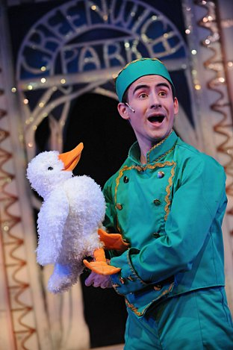
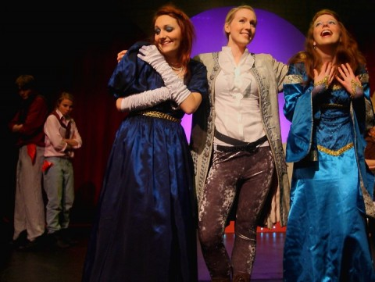
PANTOMIME
Yr 7 Drama
Lesson 2
Routines & Gags

Slide 2
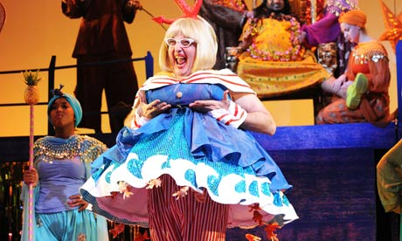
RANDOM REGISTER
In true Pantomime style let’s answer the register with an unusually large and exaggerated performance.
You can say “Yes Sir” any way that you like but you must stand up and add a very large and over the top gesture!

Slide 3
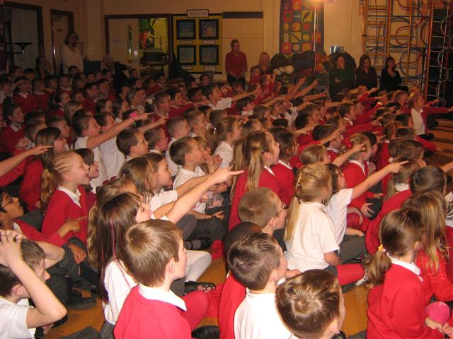
LESSON OBJECTIVE
To investigate
‘Routines & Gags’

Slide 4
Level | Drama Strand
 | Creating | Performing | Reflecting
Entry | I can take part in a drama activity | I can participate in part of a group performance | I can identify positive and negative aspects within my work
1 | I can take part in a range of drama activities I can explore problems in an imagined world and make up plays from stories or other stimuli | I can participate in a short group performance I show some consideration of movement and voice in performance | I can make simple connections between the dramas I experience and my own life I can recognise when my own work and the work of others’, could be improved
2 | I can perform my own simple scenes, demonstrating an understanding of drama techniques | I can use my voice and body to create a simple character I can act out improvised dramas | I can talk about why I made certain decisions in my play I can show a basic understanding of how meaning can be shown
3 | I can establish a character with control over movement and voice I can use the dialogue in existing texts as well as creating my own I can devise plays from a range of stimuli I can respond to the use of drama techniques to deepen the role or understanding of the situation e.g. hot seating I can sustain a defined character for a reasonable amount of time | I can learn lines and organise simple performances | I can give suggestions on how work could be improved I can talk about my work using some technical drama terminology I can discuss and give reasons for my preferences in the drama I have seen

Slide 5
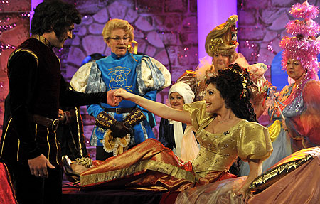
GAGS & ROUTINES
Lesson Objective:
To investigate ‘Routines & Gags’
To understand how ‘Routines & Gags’ are used within a Panto.
Gags & Routines are set pieces which can be written into any pantomime show.
If you have been to a Panto you may have seen something like what you will work on today.

Slide 6
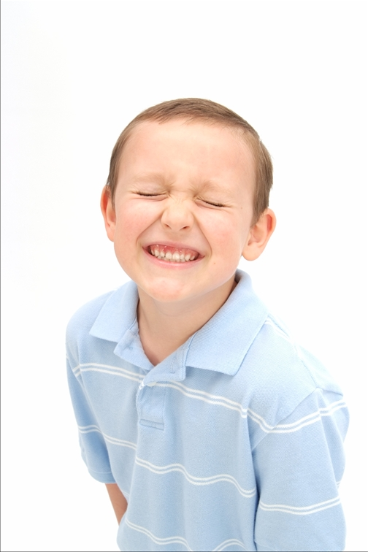
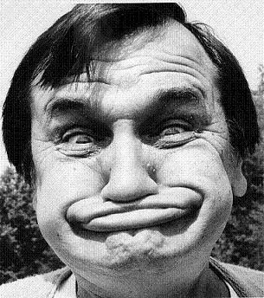
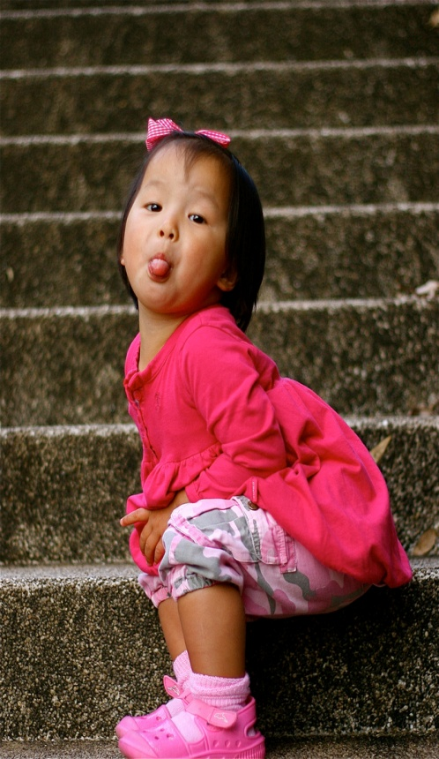
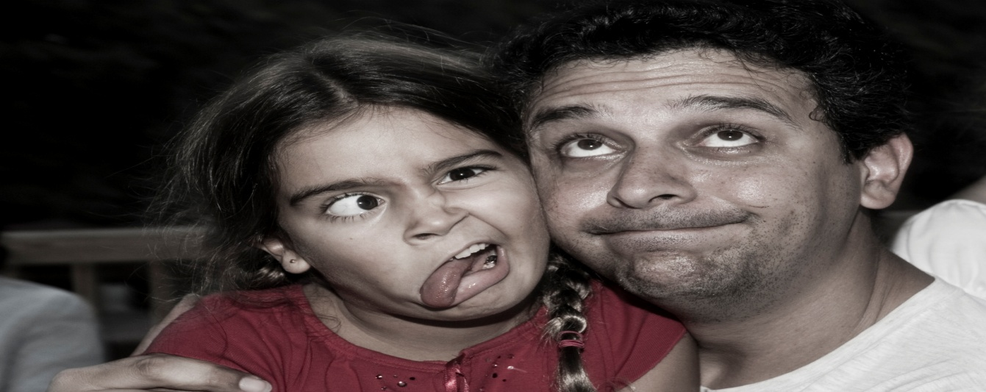
THE LOOK
Lesson Objective:
To investigate ‘Routines & Gags’
To understand how ‘Routines & Gags’ are used within a Panto.
Students look at the floor, the teacher will call out a word, the students must then look up at the audience in the style of the word they have been given. i.e. Happy, Sad, Forgetful, Confused.
Students should make the faces as comic as possible.
REMEMBER TO EXAGGERATE

Slide 7
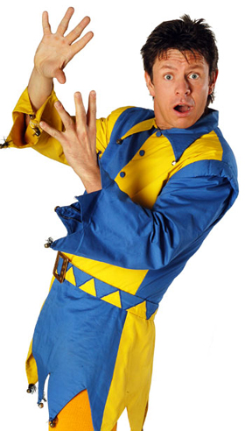
COMIC STOP
Lesson Objective:
To investigate ‘Routines & Gags’
To understand how ‘Routines & Gags’ are used within a Panto.
Walk around the space, when the teacher says a buzz word you must make a comic stop and then continue walking.
A comic stop can be any natural reaction, a shrug of the shoulders, a look to the left, a complete stop, a quick glance etc.
A comic stop must be an instant reaction, it can be any movement of the body that feels natural.

Slide 8
PANTO WALKS
Lesson Objective:
To investigate ‘Routines & Gags’
To understand how ‘Routines & Gags’ are used within a Panto.
THE SCARY WALK
COME HERE-WALK AWAY
SQUEEKY SHOE
SSSH SILENT WALK.
THE DESCRIBING WALK!
https://www.youtube.com/watch?v=jTe0q4UFvn0
https://www.youtube.com/watch?v=CSwF8DpO2eQ
https://www.youtube.com/watch?v=ouSa30NdJyM
Notes:
Talk to students about the different types of walks. Then get students to stand up and spend one minute of each type of walk. There are a few examples to show them so you might want to do this first.

Slide 9
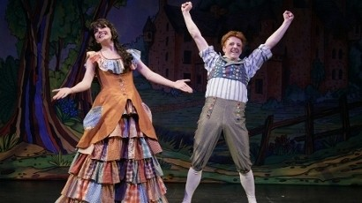
THE REPEATING GAG
Lesson Objective:
To investigate ‘Routines & Gags’
To understand how ‘Routines & Gags’ are used within a Panto.
One pupil in front, one slightly behind. The pupil behind copies actions of the one in front but in a silly and stupid fashion. The pupil in front turns round to look at him when audience laugh but does not catch him.

Slide 10
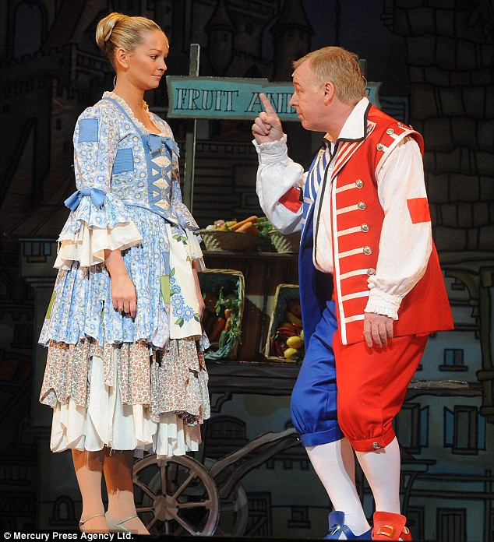
REPEATING GAG
Lesson Objective:
To investigate ‘Routines & Gags’
To understand how ‘Routines & Gags’ are used within a Panto.
In a pair, students stand next to each other. One pupil (b) clearly copies the other, repeating everything the other student says and does, eventually the pupil (a) who is being copied, says “why are you copying me?” The other pupil continues copying until pupil (a) storms off. Pupil (b) then says to the audience “I thought he’d never leave”.

Slide 11
THE TASK
Lesson Objective:
To investigate ‘Routines & Gags’
To understand how ‘Routines & Gags’ are used within a Panto.
In pairs you must choose from the following options…
Practice and rehearse 1 routine you have learnt today
Put together a series of routines from the gags and routines you have learnt.
Make up your own routine.

Slide 12
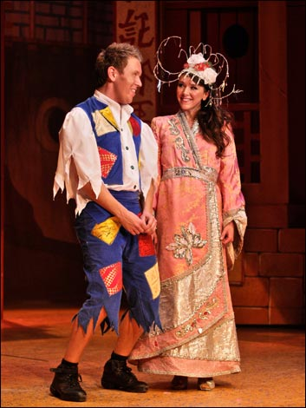
WHAT DID YOU ACHIEVE TODAY?
Lesson Objective:
To investigate ‘Routines & Gags’
To understand how ‘Routines & Gags’ are used within a Panto.
Summing up:
What have you learnt today?
What level have you achieve and how/ why?
What do you need to do to meet your target grade?
Get into a pair.
Share your knowledge and ideas with your partner

